Slide 1
A2Z Online Food Recipe Portal Business Plan
Group 12
Dec 5th, 2022
Notes:
What better topic to discuss on a Monday afternoon than food/ What better way to end a Monday afternoon session than food
Good afternoon, we are group 12 and we will be presenting our business plan for the A2Z online food recipe portal

Slide 2
Content flow
Challenges with physical recipe books
Proposed business model
Scope of the project; EER diagram and Tables details
Examples of built-in queries outputs in the portal
Customer friendly recipe filters queries
Recipes feedback queries
Customers information queries
Customized stored functions, procedures and triggers
Notes:
This will be the flow of the presentation
We will start the discussion with the challenges being faced with physical recipe books
Move on to business plan and scope of the project
Then a brief discussion on the tables and EER diagram used in the backend database system for this project
Then we will discuss about the business-related queries incorporated in the project which have been divided into 4 buckets

Slide 3



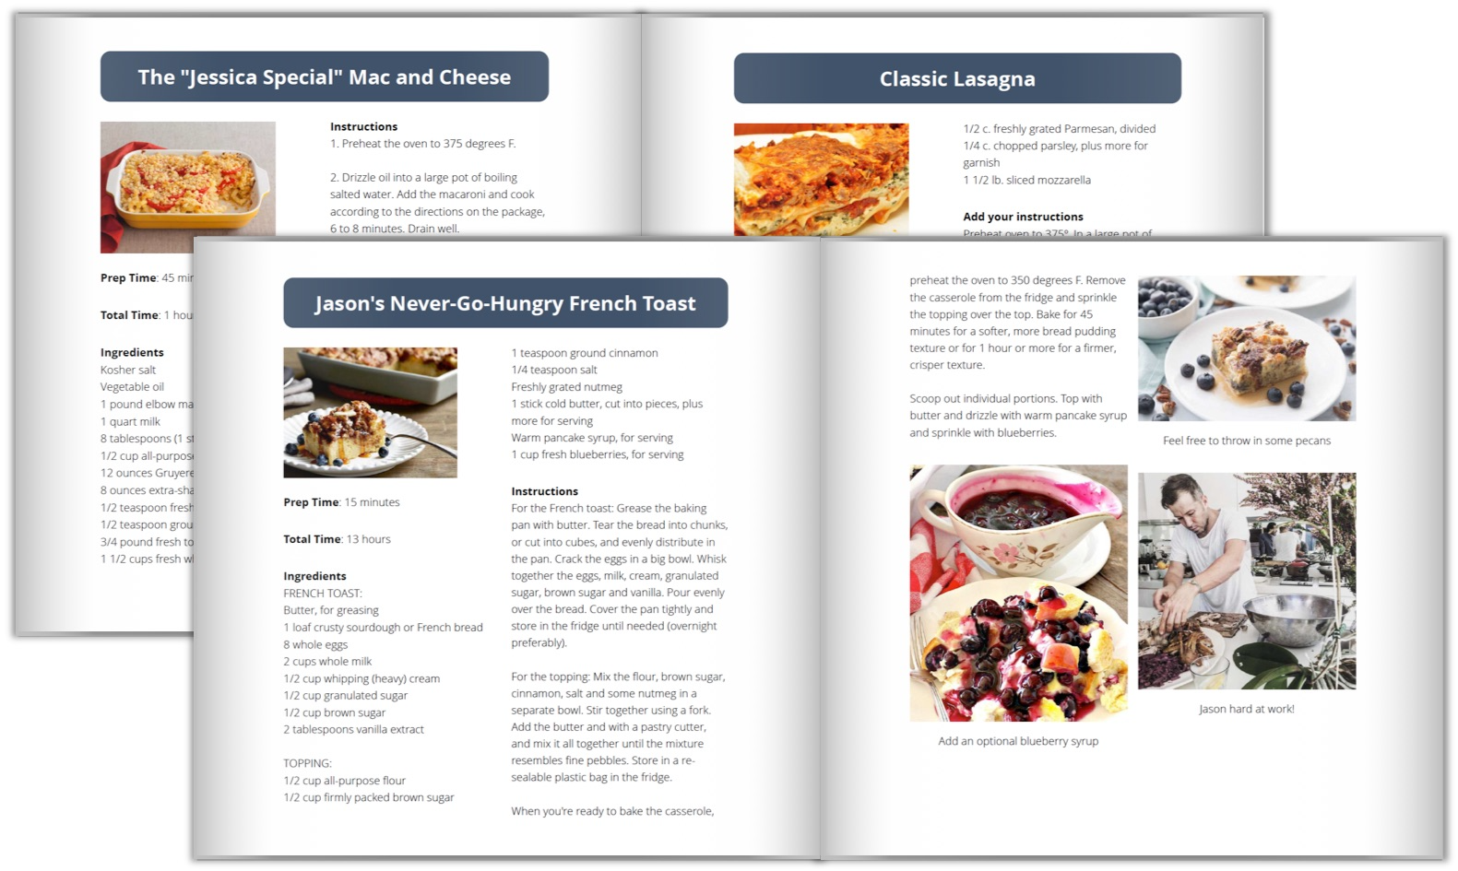

We already have recipe books… Why do we need an online portal!!
Difficult to filter recipes
No single source for all recipes
A single online repository for recipes from all over the world with modern features like custom filters, social elements, security
Difficult to maintain
Recipes can’t be updated easily
Notes:
We already have the tried and tested physical recipe books, then is there a need for an online portal?
Let’s go through some of the major challenges with the existing system
Recipes are scattered across multiple recipe books
These are hard to maintain, take space and need to properly cared for
no way to customize the filters to our needs
Only way to update the recipes to purchase a newer edition of that recipe book
We are here to solve all these issues through our A2Z online food recipe portal

Slide 4
Business Model
Customers add recipes
Customers consume recipes
Recipes are added by customers. Recipes are tagged as free and paid.
Positive feedback loop
Recipes platform
More customers come in…
More and more paid customers
Customers engage with other like-minded people and spread positive word of mouth
Notes:
I will go briefly through the business model:
We offer a platform where food lovers meet, interact, upload and consume food related content
We are taking the advantage of the positive feedback loop that is at play here to scale this business
Positive reinforcement
We offer a subscription model where the recipes which are tagged as Paid/ premium will only be available to our paid members

Slide 5
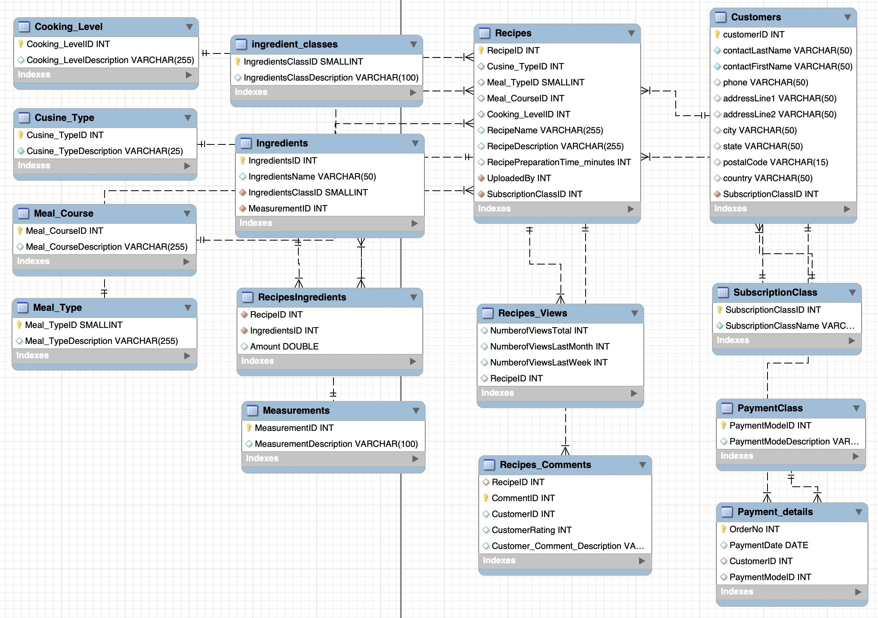
Scope of the project; EER diagram and tables used
We will focus on the backend database system built in the mySQL environment
Recipes Categorizations:
Cooking level
Cuisine Type
Meal Course
Meal Type
Customer management tables:
Customers
Subscription Class
Payment Class
Payment details
Recipes Details:
Recipes
Ingredients Class
Ingredients
Recipes ingredients
Measurements
Recipes Views
Recipes Comments

Slide 6
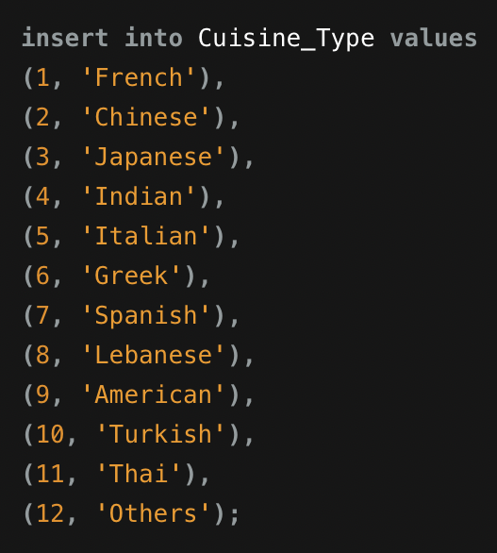
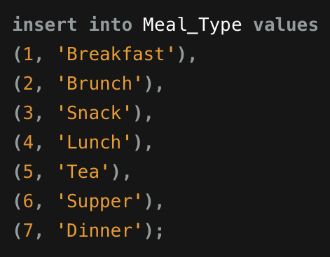
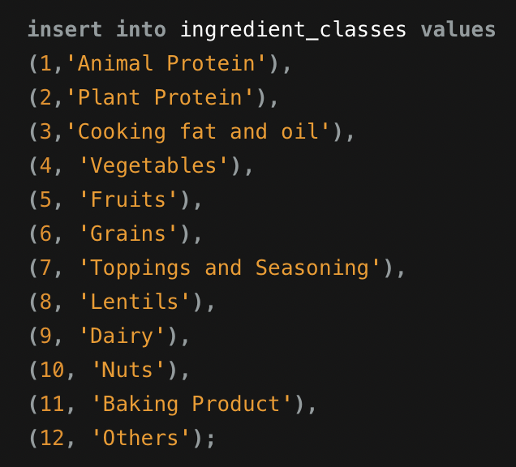
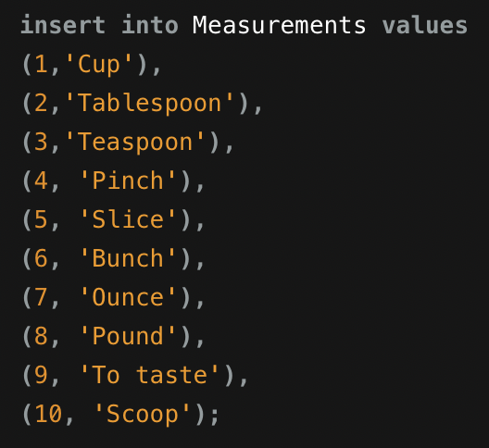
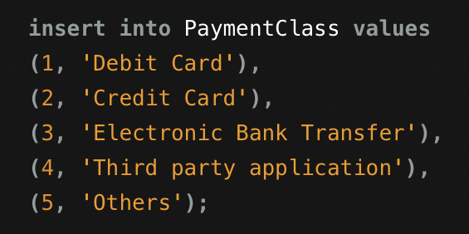
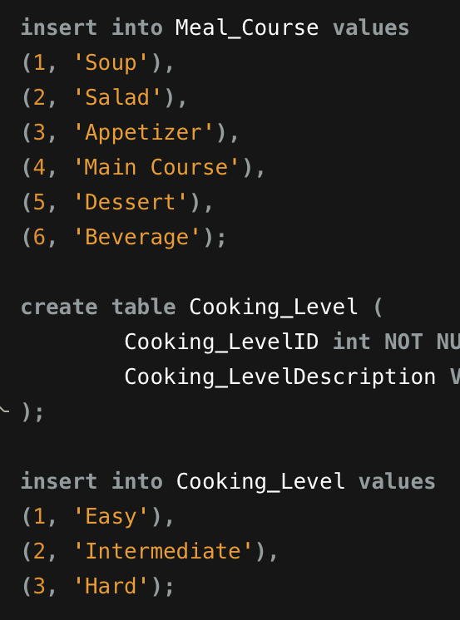
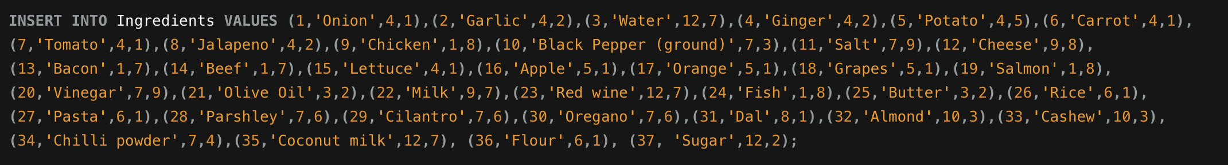
More on tables

Slide 7
Examples of business related queries
Notes:
Based on customer feedback, we have added some customized filters some of which are given below

Slide 8
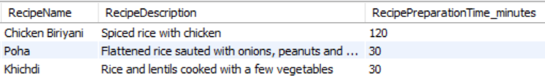
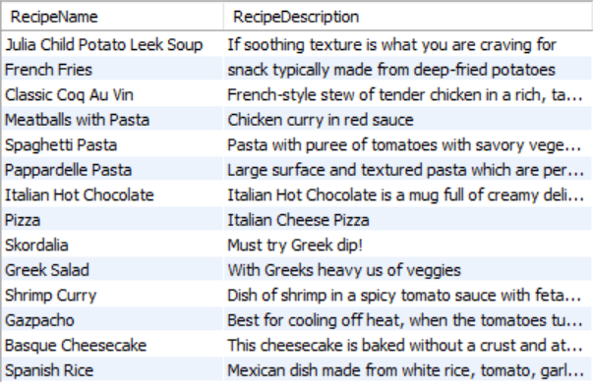
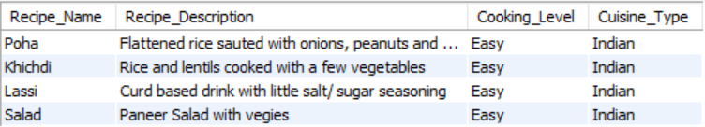
Relevant filter queries to make finding recipes smooth as butter… (1/2)
1: Recipes with ”rice” as an ingredient (Using JOIN and AND logical operator)
3: Recipes from Europe (Spanish, French, Italian and Greek recipes… Using JOIN and OR logical operator)
2: Easy level recipes from India (Using JOIN and AND logical operator)
Notes:
Rice lovers can filter recipes with rice as an ingredient
People just learning to cook Indian food can start with the Easy recipes
European cuisine lovers can get recipes from across Europe with a single click

Slide 9
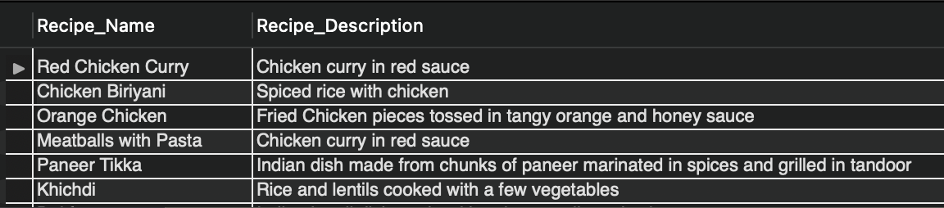
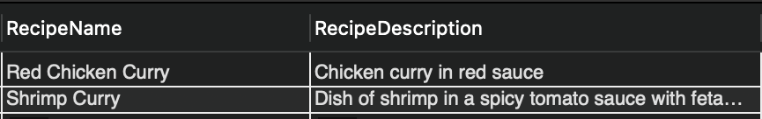
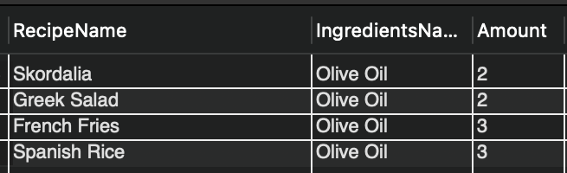
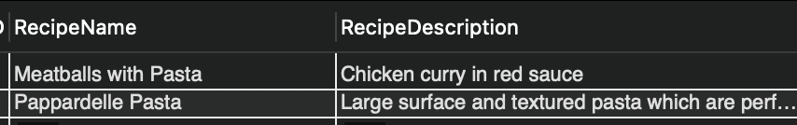
Relevant filter queries to make finding recipes smooth as butter… (2/2)
4: High protein recipes (Has animal protein, plant protein, nuts or lentils… Using JOIN, AND and IN)
6: Curry recipes (Using LIKE with % wild card character)
7: Recipes with more than 2 tablespoons of olive oil (Using JOIN, AND logical operator, >= comparison operator)
5: All pasta recipes without Spaghetti (Using LIKE, NOT LIKE with % wild card character)
Notes:
Some more examples of user filters
4. Gym goers can search for high protein recipes
5. We have a filter for Pasta lovers but Spaghetti haters as well
6. Curry recipes are also a click away
7. People who love olive oil can search for such recipes as well

Slide 10
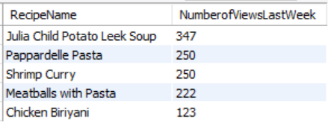
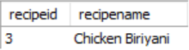
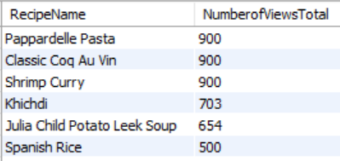
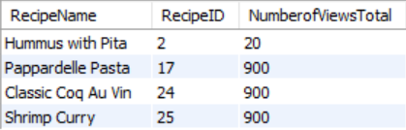
Recipe views related queries for customizing and recommending content
1: Top 5 recipes based on views last week (Using JOIN, ORDER BY and LIMIT)
3: Recipe with the 2nd highest number of comments (Using JOIN, COUNT and DISTINCT)
4: Recipes in descending order of all time views (Using INNER JOIN and ORDER BY)
2: Highest and lowest viewed recipes (Using JOIN, MIN and MAX functions)

Slide 11
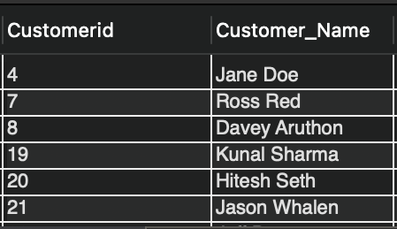
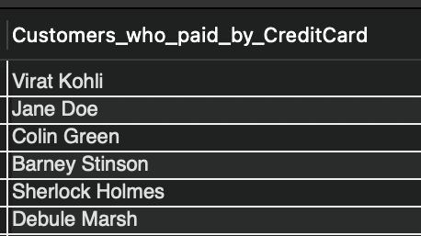
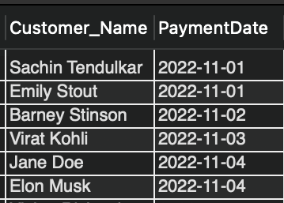
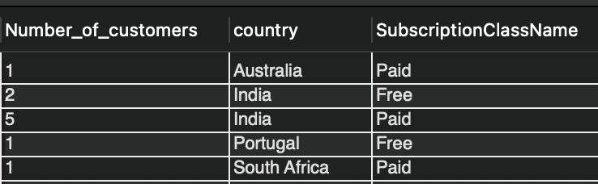
Customer related queries for strategic initiatives
1: Customers who have not uploaded any recipe yet (Using NOT IN and SUB QUERY)
3: Names of customers who paid by credit card (Using SUB QUERY, JOIN, IN, CONCAT)
2: Customer who subscribed in Nov 2022 (Using JOIN, BETWEEN)
4: Number of free and paid customers country-wise (Using JOIN, COUNT, GROUP BY, ORDER BY)

Slide 12
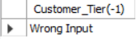
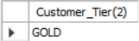
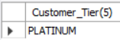
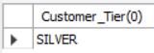
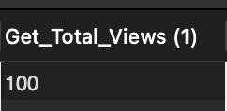
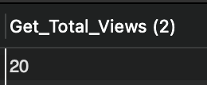
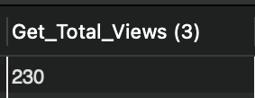
Customized stored functions to serve our customers better
1: Customer tier based on recipes uploads count
No. of Recipes uploaded | Customer Tier
More than 4 | Platinum
2-4 | Gold
1 | Silver
2: Show total recipe views based on recipe id input
Notes:
1. Next, to better cater our customers. We’ve created customized stored functions. We’ve created tier system in which a customer who uploads more than 4 recipes would be called our platinum level customer. And customers who upload between 2 to 4 recipes would be called our Gold level customers. Rest would be silver customers. Using this we want motivate platinum level customers to upload more quality recipes. We’ve decided to convert our unpaid platinum level customers into paid ones by giving them membership for free.
2. We’ve created a system where we can get total views of a recipe just be entering its recipe ID. With this system we’d be able to check views and improve upon recipes which got lower views.

Slide 13
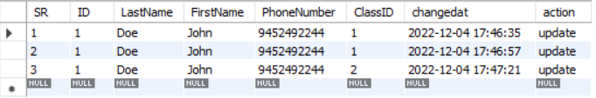
Stored procedure and Triggers to improve efficiency
1: Stored procedure to show the tiers of all customers by invoking Customer_Tier function and using WHILE loop
2: Before update trigger to keep track of customers switching from free to paid subscription
Notes:
1. To further advance our systems, we’ve also created stored procedures to improve our efficiency. One of the procedures gets all the customers names and their tiers. This would significantly reduce our time in segregating customers into various tiers and sending free membership invites to our platinum customers.
2. Moreover, we’ve created a trigger which will automatically get into action whenever a customer switches from free to paid subscription. The system would automatically store the old information in our database. This would help us in reviewing the success of the advertising expense done through reviewing customers who changed from free to paid.

Slide 14

Don’t Stay Hungry, Don’t Stay Foolish, Just log onto A2Z Recipe Portal Thank you!
Notes:
At last, we would like to thank you for your time and attention today. This is the tagline of our business “Don’t stay hungry, Don’t stay foolish”.
Just log on to A2Z recipe portal and get your favorite recipes from all over the world.

